Slide 1


ARIMA Models
Wake Forest
School of Business
_______

Slide 2
What is an ARIMA Model?
AR: Autoregressive => time series is a function of its own past
MA: Moving Average => time series is a function of past shocks (deviations, innovations, errors, etc)
I: Integrated => differenced values between successive time points will be modeled
ARIMA(p, d, q)
NOTE: ARIMA(p,0,q) = ARMA(p,q)

Slide 3

Examples
ARIMA(1,0,0): $Y_{t}= φ_{0}+φ_{1}Y_{t−1}+ε_{t}$
ARIMA(0,0,1): $Y_{t}=θ_{0}−θ_{1}ε_{t−1}+ε_{t}$
ARIMA(2,0,2): $Y_{t}= θ_{0}+φ_{1}Y_{t−1}+φ_{2}Y_{t−2}−θ_{1}ε_{t−1}−θ_{2}ε_{t−2}+ε_{t}$
ARIMA(0,1,0) (random walk): $Y_{t}−Y_{t−1}=ε_{t}$

Slide 4
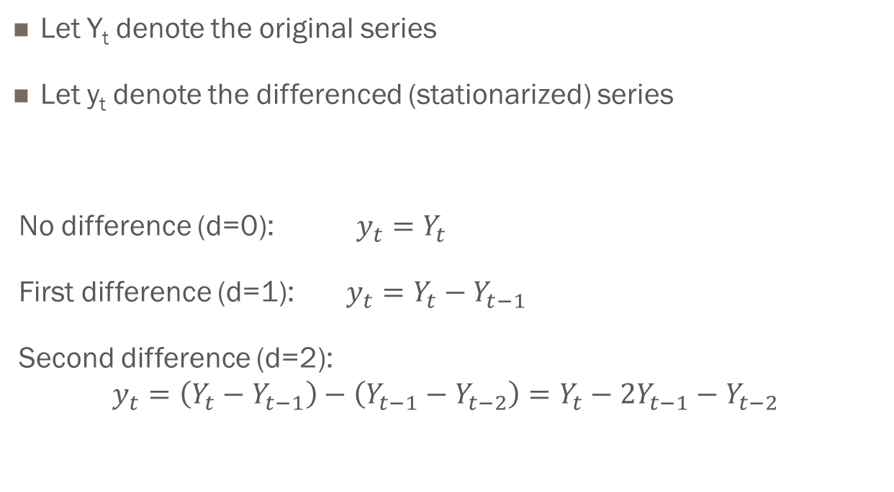
A Note on Differencing
Let Y_{t} denote the original series
Let y_{t} denote the differenced (stationarized) series
No difference (d=0): $y_{t}=Y_{t}$
First difference (d=1): $y_{t}=Y_{t}−Y_{t−1}$
Second difference (d=2):
$$y_{t}=\left(Y_{t}−Y_{t−1}\right)−\left(Y_{t−1}−Y_{t−2}\right)=Y_{t}−2Y_{t−1}−Y_{t−2}$$

